Slide 1
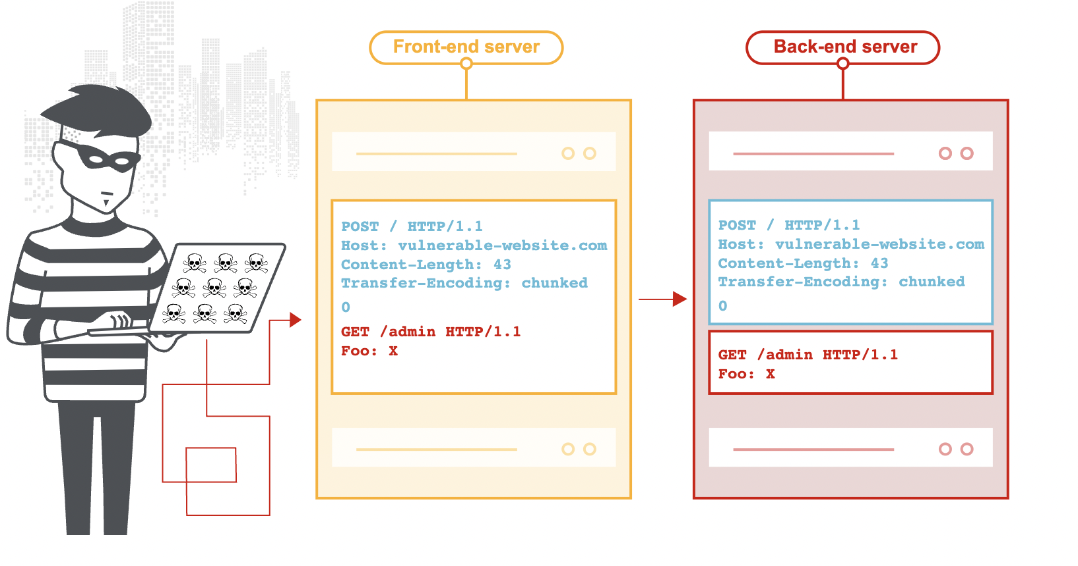
Request Smuggling
A Survey from HTTP/1.1 to HTTP/2.0
Vaibhav Singh

Slide 2
Agenda
Motivation
What is Request Smuggling?
Plans for the survey
Next Steps

Slide 3

Motivation

Slide 4




https://portswigger.net/daily-swig/network-security
HTTP
?
?
TCP
WXYZ
?
??
??
?
UDP
ABCD
?
?????
?
SNMP
Notes:
So, I was confused between Option 1 and Option 2. I love to play hands on with simulations and attacks and due to my TCP experience, my thought was to find something really interesting and new in TCP. But everything brought me back to issues similar to what I had already worked on.
So, next came HTTP coz my teammates worked on it.. and the search started to enter a loop and my confusion kept building up.
Then I remembered portswigger’s daily swig which some people used to mention. So, I went on to this website with the hope of finding something that sounds interesting. Recently, I delivered a session on Cache poisoning reloaded and somehow that term “reloaded” and its synonyms really got my interest towards network security

Slide 5

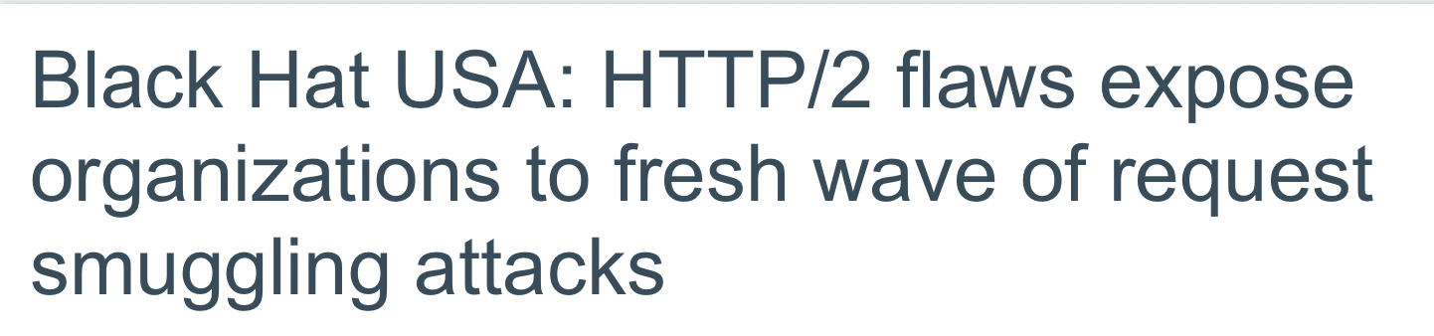

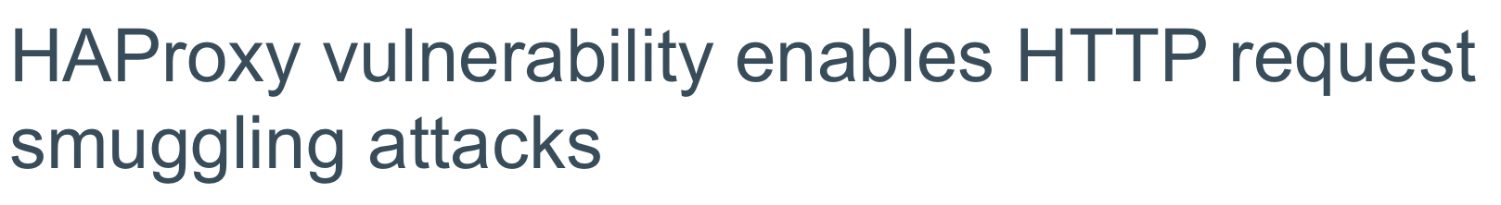
Notes:
So my initial idea was that may be its something very interesting which I can try to simulate!!
But I was bombarded with the variety of information that I started to find here!!
So, I thought that i can try to learn it better through this course and try to simulate it later during summer holidays!!

Slide 6
Request Smuggling (HTTP desync attack)
“Technique for interfering with the way a website processes
sequences of HTTP requests”
( Mitigation Bypass attack )
Allows an attacker to bypass security controls
gain unauthorized access to sensitive data
HTTP request smuggling was first documented in 2005,
and recently re-popularized by PortSwigger's research on the topic.
Notes:
Mitigation bypass is a process of fighting against and breaking mitigation measures in an environment where mitigations are enabled for the ultimate end of arbitrary code execution

Slide 7
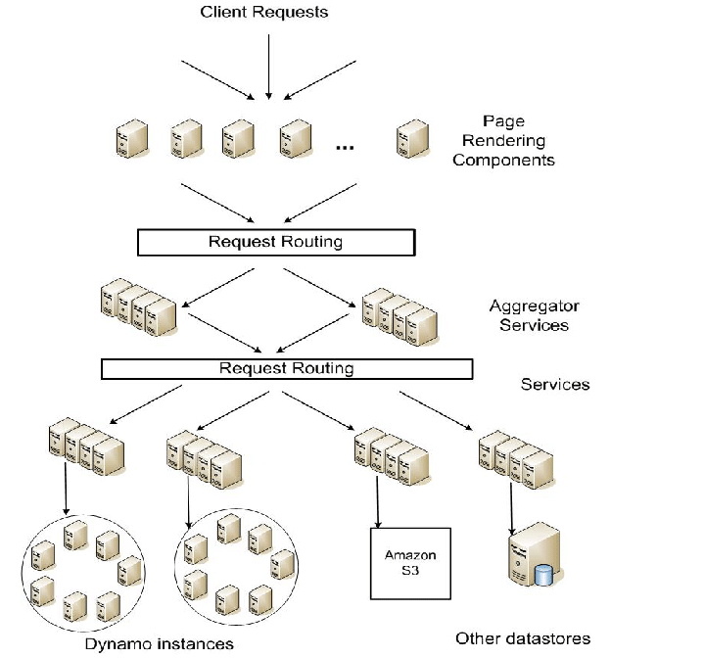
Today's web applications frequently employ chains
of HTTP servers between users and
the ultimate application logic.
Several requests are sent one after the other
on the same backend network connection.
Amazon’s SOA
https://www.allthingsdistributed.com/files/amazon-dynamo-sosp2007.pdf
Notes:
User send the request to the frontend which is the Load balancing or proxy server. LB server routes the request based on its LB policy to one or more servers

Slide 8
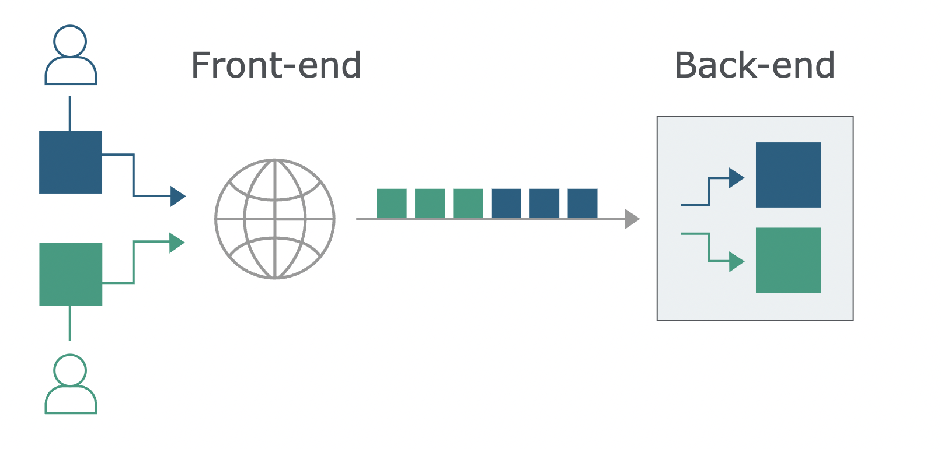
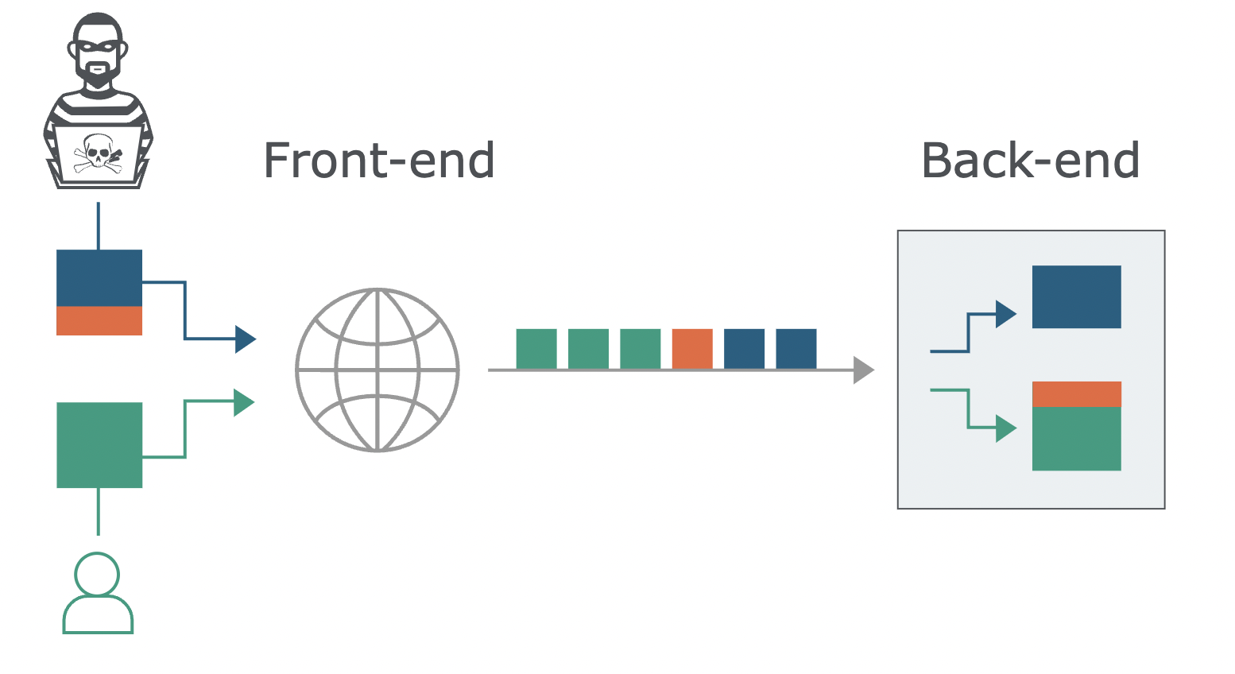

Receiving server parses the HTTP request
headers to determine where one request
ends and the next one begins
Crucial that the front-end and
back-end systems agree about
the boundaries between requests.
If there’s no agreement
Attacker can create disparity in interpretations
between front-end and back-end systems.
Attacker prepended part of its request to the next request!!
Request Smuggling
https://portswigger.net/web-security/request-smuggling

Slide 9

Plans for the survey

Slide 10
What is Request Smuggling?
Standard types of Request Smuggling
CL.TE, TE.CL, TE.TE
Content-Length header and the Transfer-Encoding header are placed in a single HTTP request
Manipulate these so that the front-end and back-end servers process the request differently.
Abusing HTTP/1.1 Request Smuggling – Use cases
Request Smuggling reborn
https://portswigger.net/research/http-desync-attacks-request-smuggling-reborn
Newly discovered H2C request smuggling attack (HTTP/2.0)
https://bishopfox.com/blog/h2c-smuggling-request
Related CVEs
Industry stories
F5, Cisco, Citrix, Red Hat blogs
Tools to try Desync attack – An overview
Notes:
Most HTTP request smuggling vulnerabilities arise because the HTTP specification provides two different ways to specify where a request ends: the Content-Length header and the Transfer-Encoding header.

Slide 11
Next steps
Hands–on simulations
Study on Defense mechanisms for HTTP/1.1
Explore custom mitigations from top vendors
Explore the possibilities in HTTP/3.0

Slide 12

Questions?

